Slide 1
Dynamic Programming
0750323 Algorithms
Dr. Raneem Qaddoura

Slide 2
Dynamic Programming
Dynamic programming is an algorithm design technique invented for optimizing multistage decision processes.
The word “programming” in the name of this technique stands for “planning” and does not refer to computer programming.
After proving its worth as an important tool of applied mathematics, dynamic programming has eventually come to be considered, at least in computer science circles, as a general algorithm design technique that does not have to be limited to special types of optimization problems.
Dynamic programming is a technique for solving problems with overlapping subproblems.
Typically, these subproblems arise from a recurrence relating a given problem’s solution to solutions of its smaller subproblems.
Rather than solving overlapping subproblems again and again, dynamic programming suggests solving each of the smaller subproblems only once and recording the results in a table from which a solution to the original problem can then be obtained.

Slide 3
Warshall’s and Floyd’s Algorithms
Warshall’s algorithm for computing the transitive closure of a directed graph and Floyd’s algorithm for the all-pairs shortest-paths problem.
These algorithms are based on essentially the same idea: exploit a relationship between a problem and its simpler rather than smaller version.
Warshall and Floyd published their algorithms without mentioning dynamic programming.
Nevertheless, the algorithms certainly have a dynamic programming flavor and have come to be considered applications of this technique.

Slide 4
Warshall’s algorithm

Slide 5
Warshall’s algorithm
DEFINITION The transitive closure of a directed graph with n vertices can be defined as the n × n boolean matrix T = {$t_{ij}$}, in which the element in the $i^{th}$ row and the $j^{th}$ column is 1 if there exists a nontrivial path (i.e., directed path of a positive length) from the $i^{th}$ vertex to the $j^{th}$ vertex; otherwise, $j^{th}$ is 0.

Slide 6
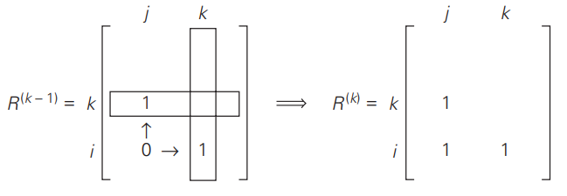
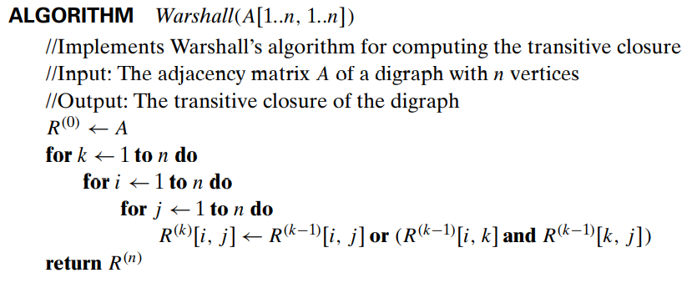
Warshall’s algorithm
This formula implies the following rule for generating elements of matrix $R^{(k)}$ from elements of matrix $R^{(k−1)}$, which is particularly convenient for applying Warshall’s algorithm by hand: If an element $r_{ij}$ is 1 in $R^{(k−1)}$, it remains 1 in $R^{(k)}$. If an element $r_{ij}$ is 0 in $R^{(k−1)}$, it has to be changed to 1 in $R^{(k)}$ if and only if the element in its row i and column k and the element in its column j and row k are both 1’s in $R^{(k−1)}$.
Time Efficiency

Slide 7
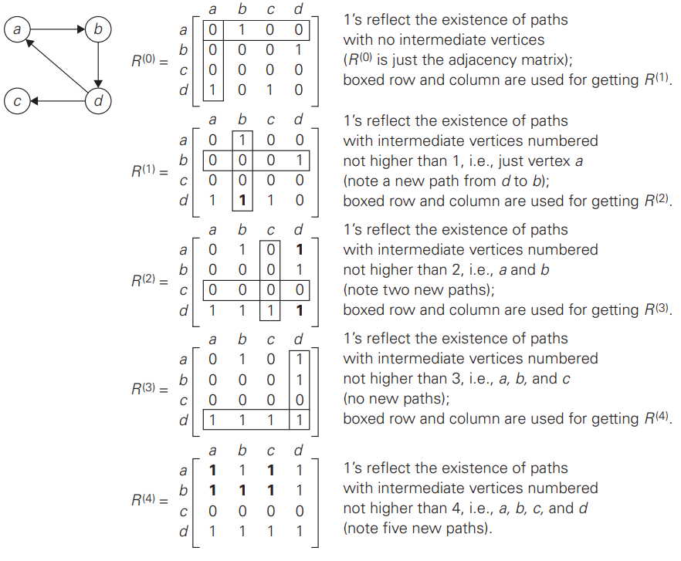

Slide 8
Floyd’s Algorithm

Slide 9
Floyd’s Algorithm
Problem: Given a weighted connected graph (undirected or directed), the all-pairs shortest paths problem asks to find the distances—i.e., the lengths of the shortest paths— from each vertex to all other vertices.

Slide 10
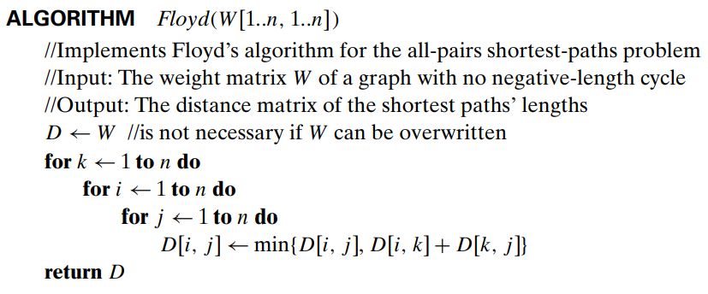
Floyd’s Algorithm
Since the length of the shortest path from $v_{i}$ to vk among the paths that use intermediate vertices numbered not higher than k − 1 is equal to $d_{ik}^{(k−1)}$ and the length of the shortest path from $v_{k}$ to $v_{j}$ among the paths that use intermediate vertices numbered not higher than k − 1 is equal to $d_{kj}^{(k−1)}$, the length of the shortest path among the paths that use the kth vertex is equal to $d_{ik}^{(k−1)}$ + $d_{kj}^{(k−1)}$ .
The element in row i and column j of the current distance matrix $D^{(k−1)}$ is replaced by the sum of the elements in the same row i and the column k and in the same column j and the row k if and only if the latter sum is smaller than its current value.
Time Efficiency

Slide 12
References
Levitin, A. (2011). Introduction to the design & analysis of algorithms. Boston: Pearson.

